Slide 1
General Management Programme
Orientation Session
3rd May, 2023
Notes:
Dear Leaders, A very Good evening to one and all
My name is Goutham and I am the programme manager at ISB Executive Education department.
On behalf of ISB and the team at Executive Education department, I welcome you all to the

Slide 2
Agenda
ISB: An Introduction
Programme Details and Cohort Profile
Connect Opportunities and Learning Management System: Introduction and Demo
Introduction to the Core Team
Q & A

Slide 3
ISB’s Vision
To be an internationally top-ranked, research-driven,
independent management institution
that grooms future leaders for India and the World
Internationally
top-ranked
To be among the Top- ranked B-Schools in the world
Research Driven
Focus on knowledge creation with emphasis on emerging economies
Independent
Autonomous Institution registered as a Section 25 (Non-Profit) Company
Notes:
ISB was launched in the year 2001 as a non-profit private business school with a vision to…

Slide 4

ISB Today
#₁
#₃₉
#₁
#4
in India by the Financial Times Global MBA 2023 Rankings
In Asia by the Financial Times Global MBA 2023 Rankings
Globally by the Financial Times Global MBA 2023 Rankings
In India by Financial Times (FT) for Executive Education Custom Rankings 2022
#₇
#6
#38
#11
globally by the Forbes Best Business Schools Ranking (2019)
in the Asia Pacific region by the Bloomberg Businessweek Best B-schools Rankings (2019)
globally by ‘Poets & Quants’ Top International MBA Programs 2021-2022
globally by Financial Times (FT) for Executive Education Custom Rankings 2022
Notes:
With that powerful vision, over the last 22 years, ISB, has contributed immensely in the area of education and has been recognised for its contributions by various organisations including the Financial Times, Forbes Business, Bloomberg Business, etc.
In 2022, ISB was ranked #1 in India by the Financial Times in Global MBA and Executive Education Custom programmes. At the global level, we stood at #39 in MBA ranking and #38 in Executive Education ranking for the year 2022.

Slide 5






Accreditations and Affiliations
Accreditations
Founding & Associate Schools
One out of ~100 select business schools worldwide that has triple crown accreditation - AACSB, EQUIS and AMBA accreditations
Ranked in the top 100 research institutions in the world (UTD research rankings 2019 – the only Indian B-school present.
The ISB has been accredited by the EFMD Quality Improvement system and by the Executive MBA Council.
Notes:
Our strong partnership with our founding schools, Kellogg & Wharton and our associate schools like LBS, MIT and Fletcher help us raise our benchmark to the global standards.
We are one of the select 100 business schools across the globe that has triple crown accreditations from AACSB, EQUIS and AMBA. ISB has been accredited by the EFMD Quality Improvement System and the Executive MBA Council.

Slide 6
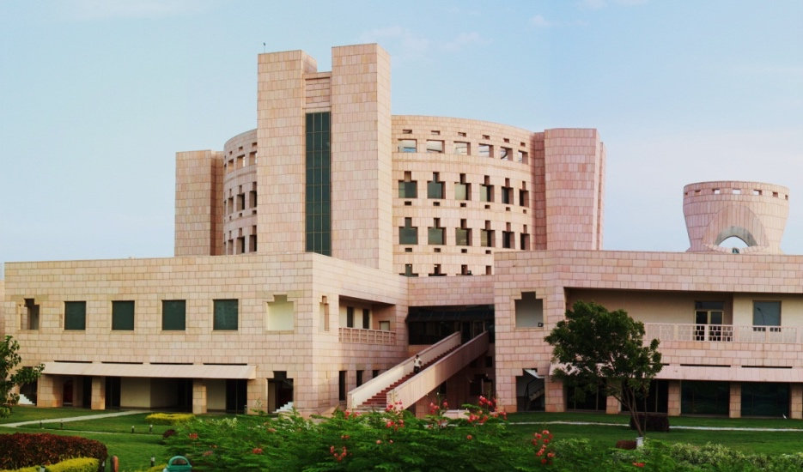
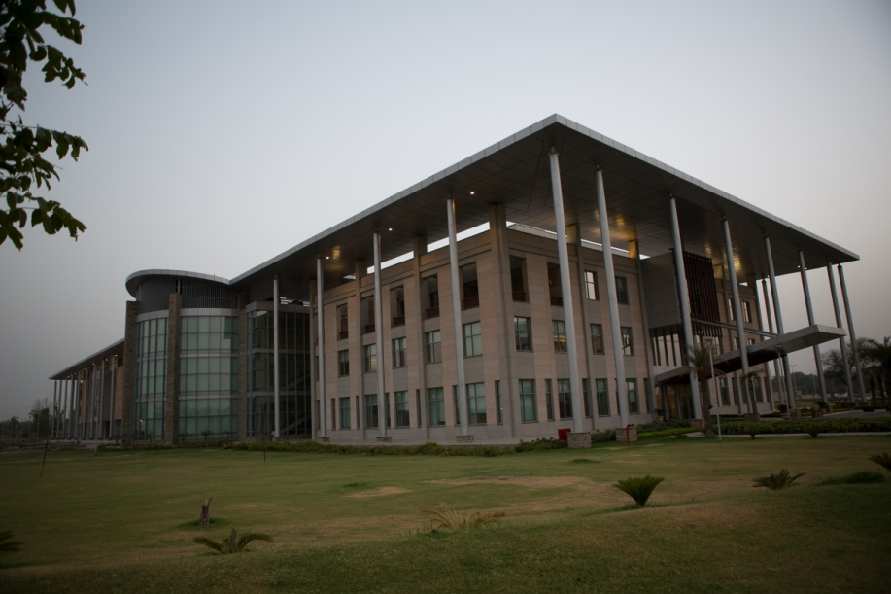
One School. Two Campuses
The Mohali Campus
The Hyderabad Campus
Consistency and a shared culture of excellence across both campuses
Notes:
The stature ISB has earned over a span of 22 years is also due to the consistency in our deliverables across both our campuses located at Hyderabad and Mohali.
We take pride in this fact as we have the same faculty, same staff, common systems & processes, and similar facilities that showcase a shared culture of excellence and that’s why we call it. One School. Two campuses.

Slide 7
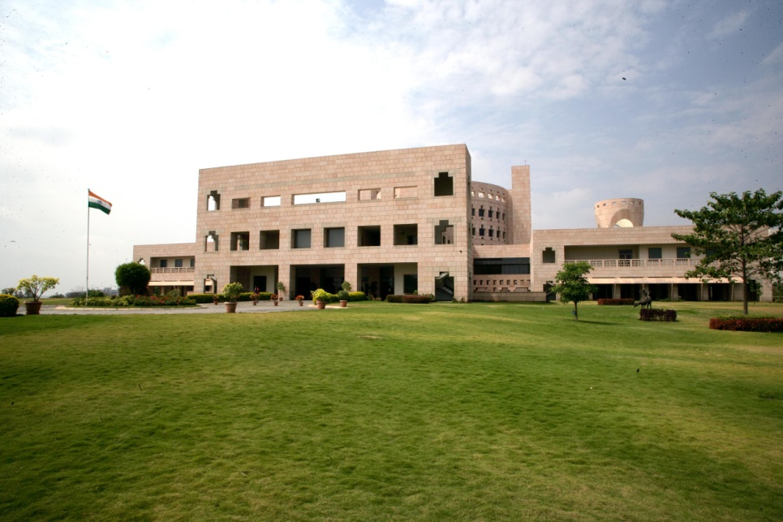
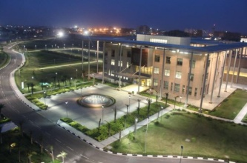
Centres of Excellence
Executive Education
Centre for Analytical Finance
Centre for Business Markets
Centre for Learning and Management Practice
Srini Raju Centre for IT and the Networked Economy
Thomas Schmidheiny Center for Family Enterprise
Center for Business Innovation
ISB Institute of Data Science
Mohali campus
Bharti Institute of Public Policy
Max Institute of Healthcare Management
Munjal Institute for Global Manufacturing
Punj Lloyd Institute of Infrastructure Management
Hyderabad campus
Develop talent and deepen research-based knowledge in specialised verticals critical to India’s development.
Connect industry and academia to advance education, research and outreach in key areas.
Notes:
Across these two campuses are located our research centres that aid in building a bridge between industry and academia.
These research centres operate in specialised domains and work closely with corporates to help them overcome business challenges. They also partner with government entities and the PSU’s to assist in policy making for our country.

Slide 8
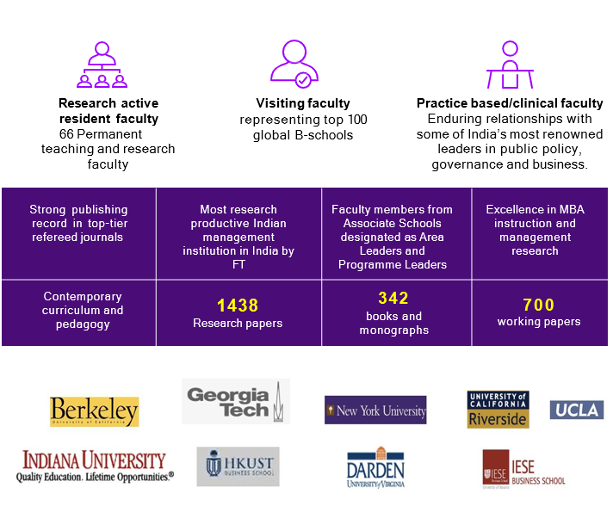
Faculty Overview
ISB has a unique and diverse Faculty Portfolio with following features:
66+ Research active resident faculty
Visiting faculty representing top 100 global B-schools
Practice based / Clinical faculty - renowned leaders in Strategy, Innovation, Marketing, Finance and Leadership.
Leverage the faculty and expertise of Centers of Excellence
Notes:
Our strength has been the unique faculty portfolio we provide. We have 70+ permanent resident and research faculty and another 200+ faculties representing various global B-Schools who facilitate in our programmes each year.
In addition to this, we also have participation from industry leaders, guest speakers and experts from our research centres who bring global perspectives to Indian contexts for a great learning experience for our executive participants.

Slide 9









Executive Education at ISB
EE at ISB undertakes a variety of Open, Enterprise and Government programmes. Over the last decade, EE has provided training to more than 50,000 executives from India and overseas across 1300+ programs.
EE Advantage @ ISB
Client-centric approach
World-class faculty
Focus on emerging market realities
International partnerships
Business understanding in program design
Deep domain expertise
Immediately applicable ALPs
Organization transformation feasibility
Notes:
At ISB Executive Education, we specialise in providing curated courses for the working professionals. These courses are provided in the B2B and B2C spheres. These courses are specially designed to help our executive participants upskill themselves to overcome challenges in these dynamic times. The course are provided in various delivery formats like on-campus, Live Virtual, self-paced learning and blended modes.

Slide 10

Programmes Delivered Around the Globe
UK
Canada
Germany
Switzerland
USA
Spain
Dubai
Japan
Oman
Mexico
Sri Lanka
Singapore
Chile
Notes:
We deliver these programmes across the globe and have participation in our programmes from across the globe.

Slide 11

























































Executive Education Clients

Slide 12






Programme Highlights
On-Campus Learning
Live Virtual Classroom
Self - Paced Learning
Real World Application
World Class Faculty
Research Based Teaching

Slide 13
General Management Programme, Batch 7
Duration​ - 9 Months​
Start Date - 3rd May 2023
End Date - 5th Feb 2024
Learning Hours​ - 150+ Hours (On-Campus, Live Virtual, Self-Paced)
On-Campus Immersions​
ISB Mohali – 14th to 16th June 2023
ISB Hyd – 3rd to 5th Feb 2024

Slide 14
Programme Modules
Module 1: Elevate Your Decision-Making Skills
CEO Perspectives: Opportunities in the new economy, Leadership and strategy in uncertain times
Module 2: Deliver Business Results
Module 3: Lead Tomorrow’s Challenges
CEO Perspectives: Personal Leadership
Module 4: Craft Your Personal Leadership Plan
CEO Perspectives: Corporate turnarounds and preparing the organisation for change
CEO Perspectives: Decision making under uncertainty, Leading execution in uncertain times, and managing crises
May - June
July - Sept
Oct - Dec
Jan - Feb

Slide 15
Core Programme Features
Live Virtual Learning
Each Live Session is of 3 hours duration
Weekday: 6:00 pm to 9:00 pm​ IST
Weekend: Saturdays – 10:00 am to 1:00 pm or 6:00 pm to 9:00 pm​ IST
​
Self-Paced Learning​
10+ hours of asynchronous learning on Learning Management System (LMS)
Accounting Fundamentals ​
Statistics for Managers ​
Critical Thinking ​
​
On-Campus Learning
Two on-campus immersions in ISB Mohali (June'23) and ISB Hyderabad (Feb'24)
Strategic Decision Making
Negotiation and Influence
Personal Leadership
Design Thinking

Slide 16
Additional Programme Features
Business Leadership Challange (June'23)
​
Engage in solving a real-world business or leadership challenge
Build connections with your peers
Undergo 3 review sessions with your mentors
Present final projects before the ISB Hyd campus immersion
Executive Coaching (Aug'23 onwards)
​
Personal and Professional assessments to identify your unique leadership style, strengths and gaps
4-month Coaching programme in cooperation with CoachHub
​
ISB Executive Education Alumni Benefits
ISB Email ID (To be provided by Mid-June)
ISB e-library (To be provided by Mid-June)
ISB ID card (To be given during on-campus immersion)
Access to ISB Executive Network LinkedIn Group (Post programme completion)
20% discount on enrolment in open executive education programmes (Post programme completion)

Slide 17
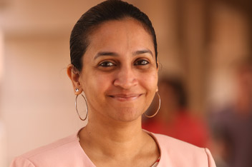
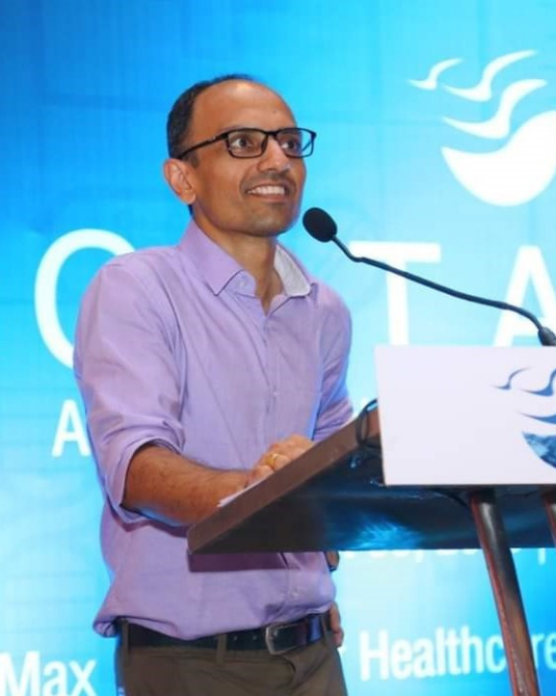
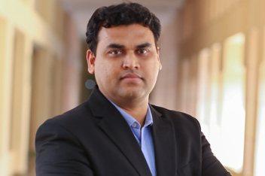
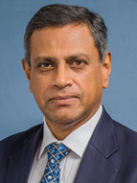
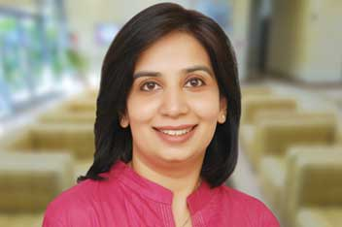
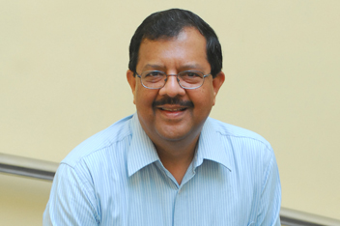
Programme Faculty
Professor Deepa Mani
Professor of Information Systems
Deputy Dean, Executive Education and Digital Learning, ISB
Area: Information Systems
PhD from University of Texas, Austin
Professor Sarang Deo
Exec. Director, Max Institute of Healthcare Management
Area: Operations Management
PhD from UCLA Anderson School of Management
Professor Hariom Manchiraju
Associate Professor of Accounting, ISB
Area: Accounting
PhD from University of New York
Professor Doreswamy Nandkishore
Professor of Marketing Strategy, ISB
Area: Marketing, Business Storytelling
PGDM from IIMA
Professor Saumya Sindhwani
Executive Director and Clinical Assistant Professor, ISB
Area: Strategy
PhD from Manchester Business School
Professor Subramaniam Ramnarayan
Professor of Organisational Behaviour, ISB
Area: Organisational Behaviour
PhD from Western Reserve University

Slide 18
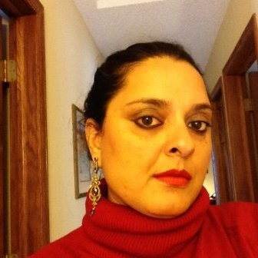
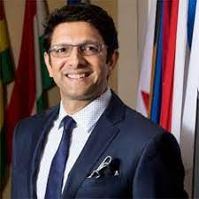
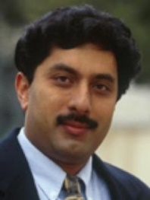
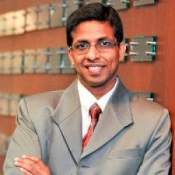
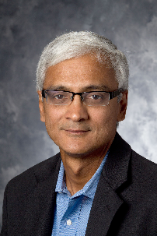
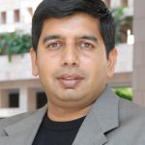
Programme Faculty
Professor Gurneeta Vasudeva
Visiting Professor, ISB
Area: Strategy
PhD from George Washington University
Professor Mihir Mankad
Visiting Professor, ISB
Area: Marketing and Communication
PhD: Harvard Kenney School of Government
Professor Anitesh Barua
Visiting Professor, ISB
Area: Information Systems
PhD from University of New York
Professor Subodha Kumar
Visiting Professor, ISB
Area: Supply Chain Management
PhD from University of Texas
Professor Sundar Bharadwaj
Visiting Professor, ISB
Area: Marketing
PhD from Texas A&M University
Professor Ravi Bapna
Professor, Finance, ISB
Area: Information Systems
PhD from University of Connecticut

Slide 19
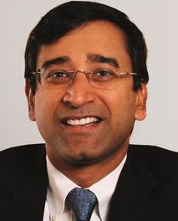
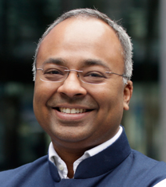
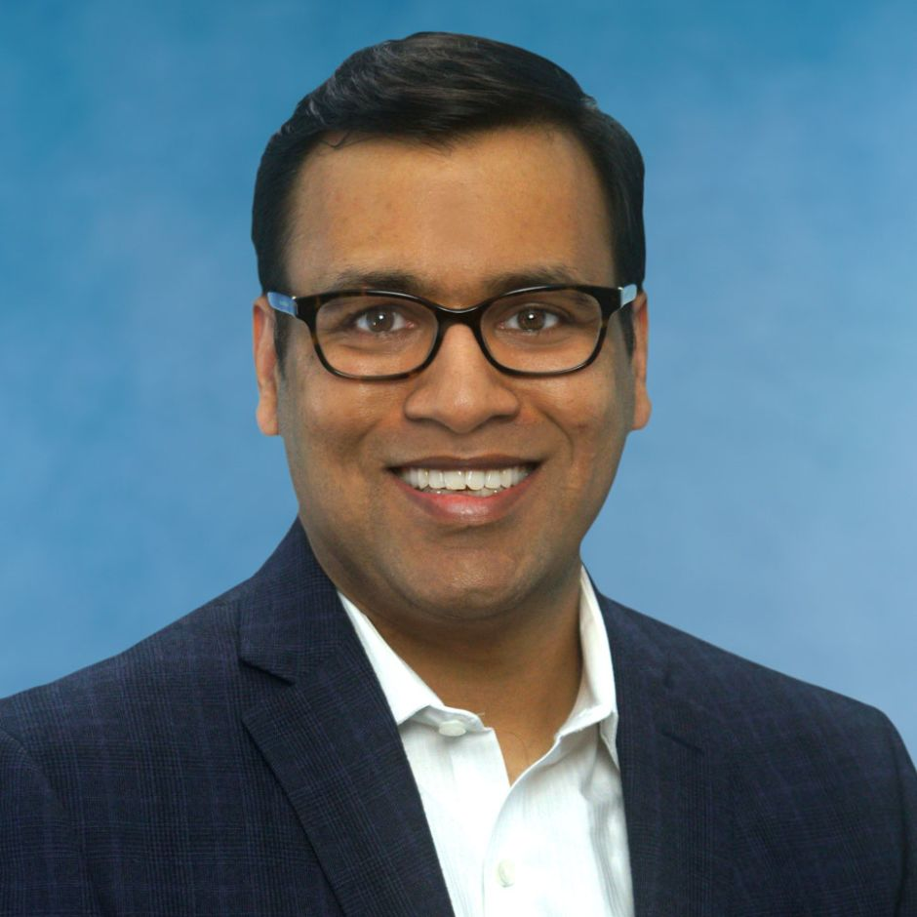
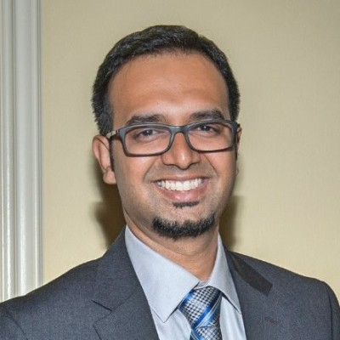
Programme Faculty
Professor Amit Goyal
Visiting Professor, ISB
Area: Finance
PhD from Anderson School, UCLA
Professor Gerry George
Visiting Professor, ISB
Area: Innovation and Entrepreneurship
PhD from Virginia Commonwealth University
Professor Pranav Jindal
Visiting Professor, ISB
Area: Marketing
PhD from University of Chicago
Professor Vishal Karungulam
Visiting Professor, ISB
Area: Information Systems
Exec MBA from Harvard Business School

Slide 20
Cohort Profile
Interviewed
100+
Onboarded
51
Applications
200+
Average Work Experience: 18.45 years
Roles: Director, General Manager, Vice President, Head of Product, Head HR, Senior Manager etc.
Industries: IT Services, Software Products, Manufacturing,
Energy & Petroleum, Pharma etc.

Slide 21












Cohort Profile

Slide 22


Connect Opportunities
Peer Dossier to know your group
Medium for Virtual Classes
Always use a laptop/desktop to attend session
Test your system/headset/internet/battery charge & bandwidth in advance
Be prepared with backup options
Login at least 5-10 minutes before the scheduled session.
Go through the pre-reads required for the class
Audio OFF/Mute when not speaking to prevent interruptions.
Video ON and Ready, we would love to see you through the sessions!!

Slide 23
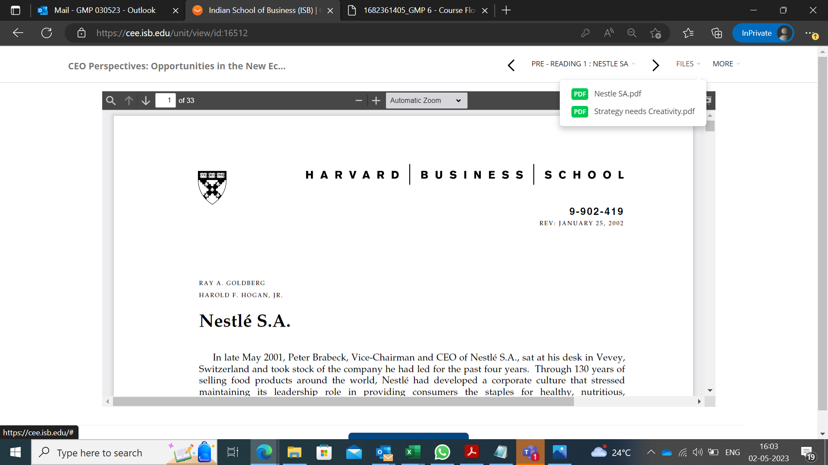
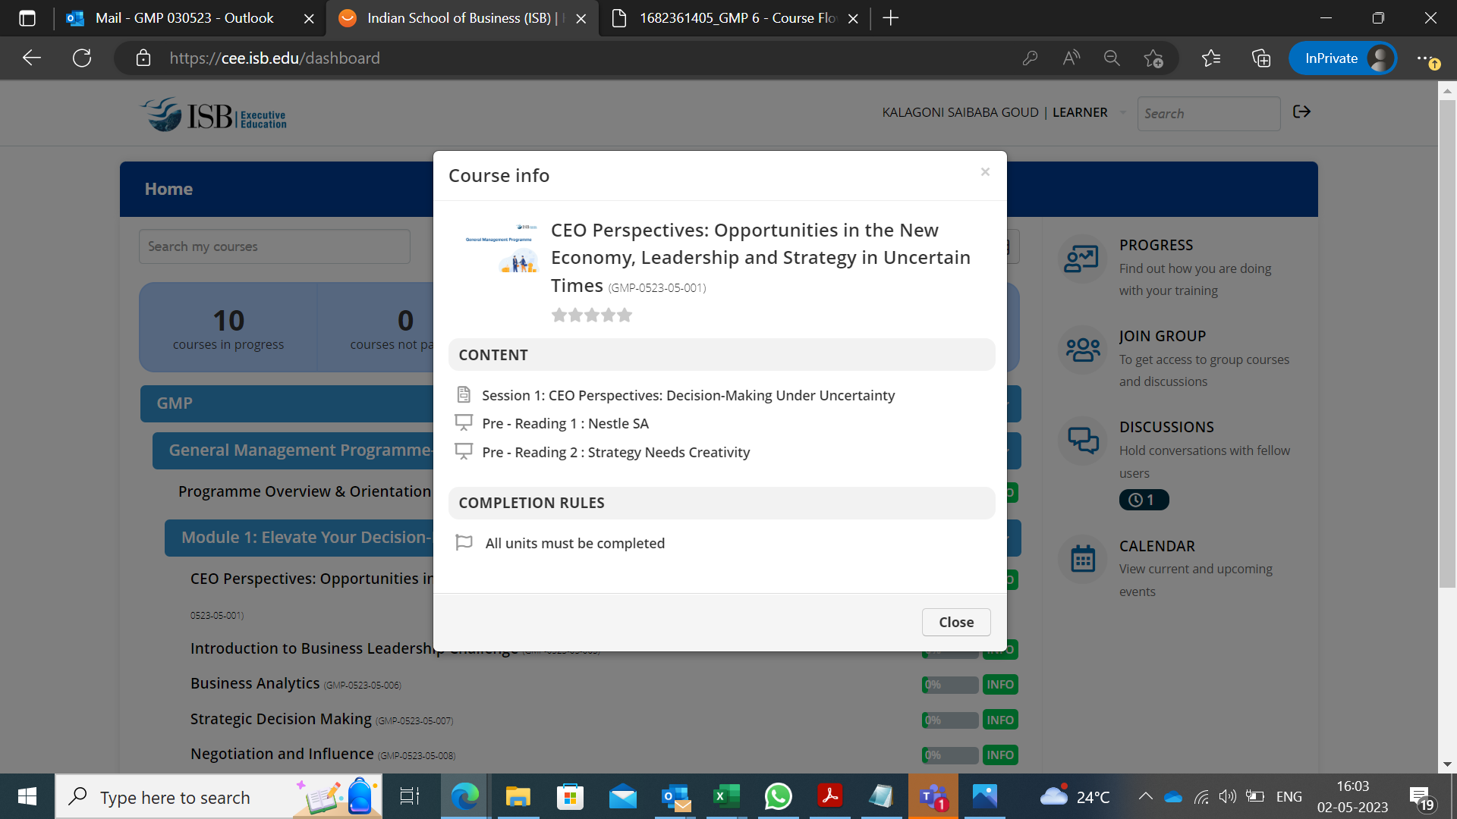
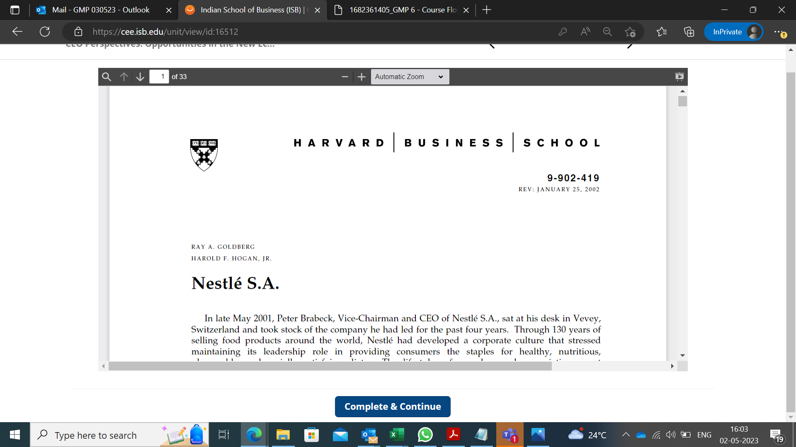
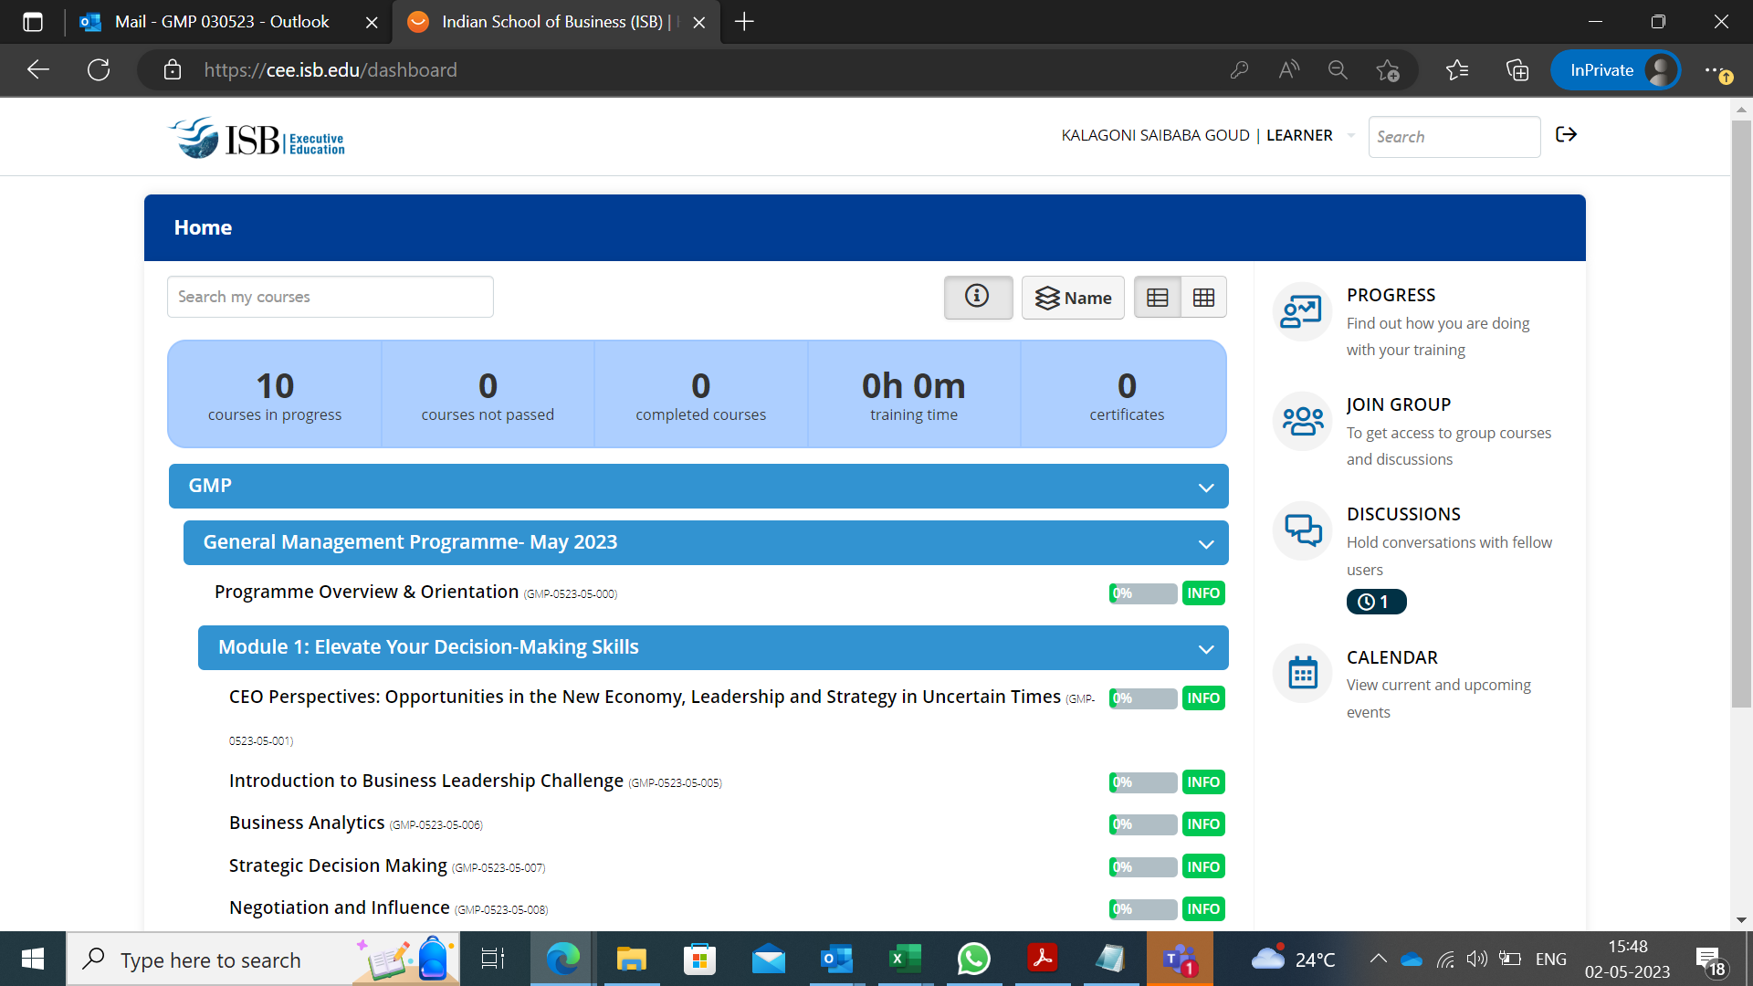
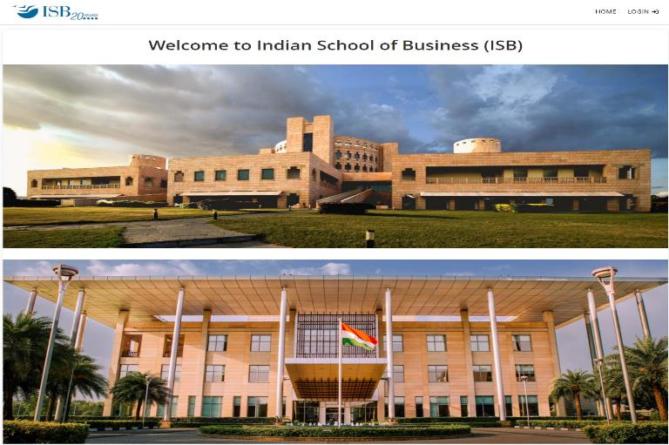
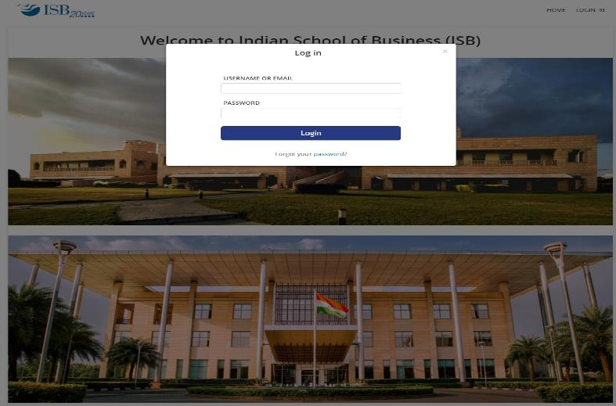
Learning Management System
Web Link :- https://cee.isb.edu
Note:- If you are having difficulty logging in, please check with your IT dept to make sure the site isn’t blocked by a Firewall.
The content is strictly confidential and exclusive to the Instructor and Indian School of Business.
You may not copy, modify, record, photograph, distribute, sell or lease any part of the programme content.

Slide 24
Additional Details
Programme Content - The learning materials including pre-reads, cases, post-reads, and articles, content slides (If applicable) are shared by faculty for every session and made available on LMS, not only for the programme period but also for 6-month post the programme completion. We encourage you to make the best use of it.
Session timings and zoom links for all Live Virtual sessions on available on LMS
Session slides and recordings (if applicable) shall be uploaded on LMS within 2 working days basis availability from faculty
In case of any unavoidable exigency, advance intimation would be given along with the changes in programme schedule
Programme Communication - The programme delivery manager will remain your point of contact throughout the programme duration. He is reachable over chat/call for assistance during working hours. Please expect a response time of 1-2 business days for queries sent on the programme email ID - GMP_030523@isb.edu
Module Feedback Form is shared post completion of a module. Please use the same to share module and faculty feedback.
On - Campus Immersion: We strongly recommend all the participants to be a part of the campus immersions. The on-campus schedule will involve module sessions, networking opportunities, certification ceremony, and much more. Programme fee includes food and accommodation at the ISB campus or at an equivalent facility based on availability.

Slide 25
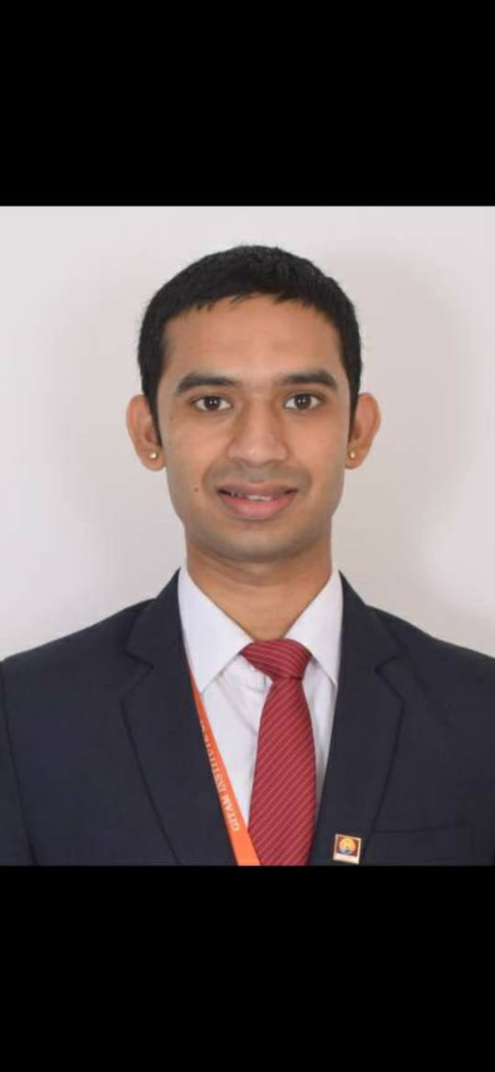
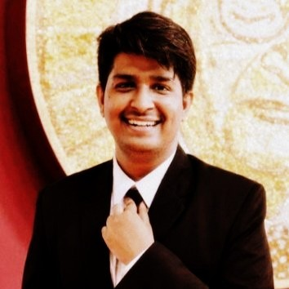
Programme Core Team
Sashank Samanchi
Manager - Programme Delivery
Email : sashank_samanchi@isb.edu
Mobile: +91 8074301945
Pranjal Singhal
Manager - Programme Management
Email : pranjal_singhal@isb.edu
25
Notes:
Here is the core team of this programme.
Sashank is the programme delivery manager and your single point of contact throughout your programme journey.

Slide 26
Q&A

Slide 27
Thank You!
GMP_030523@isb.edu
https://execed.isb.edu/
Notes:
facebook.com/isbcee
twitter.com/isb_cee
linkedin.com/company/isb_cee

